Slide 1

Armed Forces College of Medicine
AFCM

Slide 2
Hypertension
By
Dr/Tamer Elwasify , MD
Lecturer of cardiology AFCM

Slide 3
Indented Learning Outcomes (ILOs)
By the end of this lecture the student will be able to:
Define hypertension and classify it according to international guidelines (e.g., ACC/AHA, ESC/ESH).
Describe the normal physiology of blood pressure regulation.
Explain the pathophysiology of essential and secondary hypertension.
List the major risk factors for hypertension.
Identify the clinical presentation and symptoms of hypertension .
Describe the diagnostic criteria for hypertension, including proper blood pressure measurement techniques.
Discuss the different types of secondary hypertension and their causes.
Outline the complications of uncontrolled hypertension.
Explain the pharmacological and non-pharmacological management of hypertension.
Summarize the approach to hypertensive emergencies and urgencies

Slide 4
Introduction
Def of HTN :
It is the Persistent elevation of blood pressure (BP)
-The Guidelines continue to define hypertension as office systolic BP of ≥140 mmHg or diastolic BP of ≥90 mmHg.
- However, a new BP category called ‘Elevated BP’ is introduced. Elevated BP is defined as an office systolic BP of 120–139 mmHg or diastolic BP of 70–89 mmHg.

Slide 5
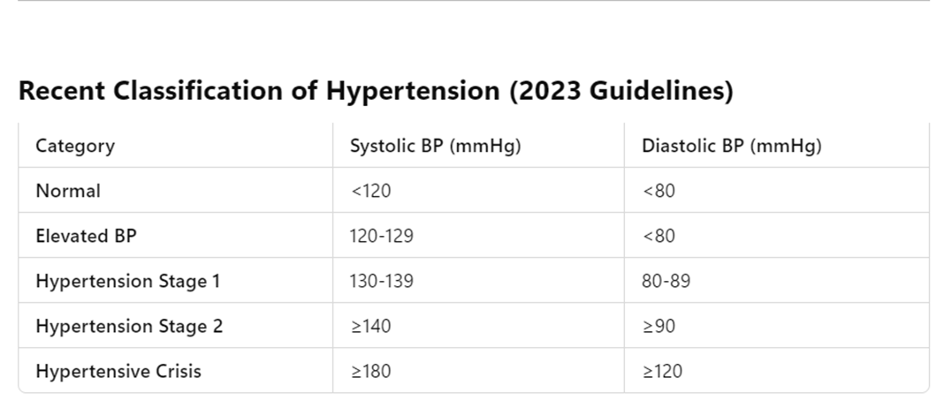
Hypertensive Urgency: BP ≥180/120 mmHg without end-organ damage
Hypertensive Emergency: BP ≥180/120 mmHg with end-organ damage.

Slide 6
Epidemiology
Hypertension Affects 1.3 billion people worldwide (WHO, 2023).
Higher prevalence in older adults, African Americans, and individuals with metabolic syndrome.
Major risk factor for:
Stroke, Myocardial infarction (MI), Heart failure (HF)
Chronic kidney disease (CKD), Aneurysms, Retinopathy

Slide 7
Risk factors for hypertension
Non-modifiable:
Age,
genetics,
ethnicity,
family history.
Modifiable:
Obesity,
sedentary lifestyle,
high sodium intake,
smoking,
alcohol use,
stress.

Slide 8
Pathophysiology and types of Hypertension

Slide 9
Types
1- Primary (Essential) Hypertension (90-95%)
No identifiable cause
Risk factors: Genetics, age, obesity, high salt intake, stress
2-Secondary Hypertension (5-10%)
Renal Causes: CKD, Renal artery stenosis
Endocrine Causes: Primary aldosteronism, Pheochromocytoma, Cushing’s
Vascular Causes: Coarctation of the aorta
Drug-Induced: NSAIDs, Steroids, OCPs, Cocaine
Sleep Disorders: Obstructive Sleep Apnea (OSA)

Slide 10
Pathophysiology of Primary hypertension
Neurohormonal Dysregulation
Overactivation of RAAS (Renin-Angiotensin-Aldosterone System) → Vasoconstriction & sodium retention.
Sympathetic Nervous System Activation
Increased heart rate & vascular resistance.
Vascular Remodeling & Endothelial Dysfunction
Chronic damage leads to arterial stiffness.
Renal Contributions
Reduced sodium excretion → Increased blood volume.

Slide 11
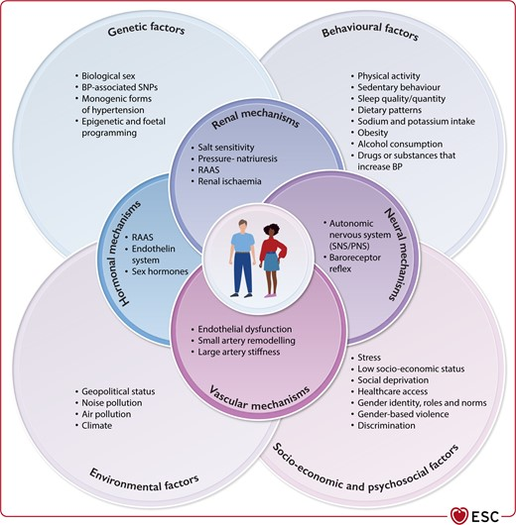

Slide 12
Pathophysiology and causes of Secondary hypertension
1 Renal Causes
Chronic Kidney Disease (CKD) – Impaired sodium excretion → Volume overload
Renovascular Hypertension (Renal Artery Stenosis) – RAAS activation → Vasoconstriction
2- Endocrine Causes
Primary Aldosteronism (Conn’s Syndrome) – Excess aldosterone → Na+ retention, Hypokalemia
Pheochromocytoma – Excess catecholamines → Episodic HTN, Palpitations, Sweating
Cushing’s Syndrome – Excess cortisol → Sodium retention, Hyperglycemia
Thyroid Disorders – Hyperthyroidism (↑ Cardiac output), Hypothyroidism (↑ Vascular resistance)
3- Vascular Causes
Coarctation of the Aorta – Narrowed aorta → Upper limb HTN, Delayed femoral pulse
4- Sleep-Related Cause
Obstructive Sleep Apnea (OSA) – Intermittent hypoxia → Sympathetic activation
5- Drug-Induced Hypertension
NSAIDs, Corticosteroids, Decongestants, Oral Contraceptives, Cocaine

Slide 13
Clinical presentation of hypertension

Slide 14
Asymptomatic (Silent Killer) 🛑
Most patients have NO symptoms, making regular screening essential. Often detected incidentally during routine check-ups.
Common Symptoms (If Present) ⚠️
🔹 Headache – Occipital, worse in the morning 🔹 Dizziness & Fatigue – Due to poor cerebral perfusion 🔹 Palpitations – Due to increased cardiac workload 🔹 Blurred Vision – Hypertensive retinopathy 🔹 Epistaxis (Nosebleeds) – Due to vascular fragility

Slide 15
Symptoms of Hypertensive Crisis 🚨
Hypertensive Urgency (BP >180/120 mmHg, NO organ damage)
Severe headache
Shortness of breath
Anxiety
Hypertensive Emergency (BP >180/120 mmHg + Organ Damage)
Neurological: Stroke, Encephalopathy (Confusion, Seizures)
Cardiac: Chest pain (MI), Heart failure
Renal: Acute kidney injury (Oliguria, Hematuria)

Slide 16
Signs of Target Organ Damage 🏥
Brain: Stroke, Cognitive impairment
Heart: Left ventricular hypertrophy, Heart failure, MI
Kidneys: Proteinuria, CKD
Eyes: Hypertensive retinopathy (AV nicking, Papilledema)

Slide 17
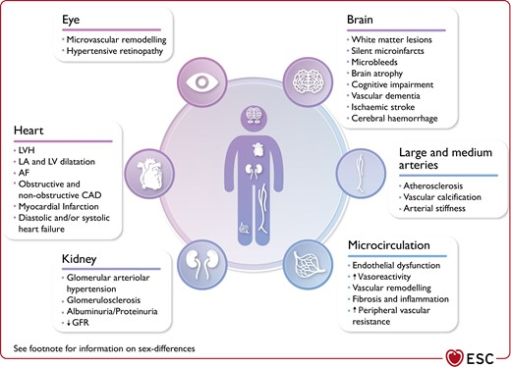
Clinical consequences of elevated BP

Slide 18
Clues suggesting secondary HTN
✅ Severe or Resistant Hypertension (Uncontrolled despite 3 drugs) ✅ Sudden Onset Hypertension in a previously normotensive individual ✅ Young age (<30 years) or Extreme BP elevations (>180/120 mmHg) ✅ Electrolyte abnormalities (e.g., Hypokalemia in primary aldosteronism) ✅ Paroxysmal Symptoms (Episodic HTN, Sweating, Palpitations → Pheochromocytoma)

Slide 19
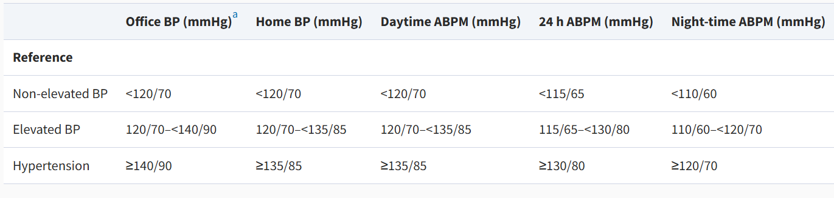
Measurement of BP

Slide 20
Steps of BP measurement
Step 1 - Choose the right equipment: 1. A quality stethoscope 2. An appropriately sized blood pressure cuff 3. A blood pressure measurement instrument
Step 2 - Prepare the patient: Make sure the patient is relaxed by allowing 5 minutes to relax before the first reading. The patient should sit upright with their upper arm positioned so it is level with their heart and feet flat on the floor. Remove excess clothing that might interfere with the BP cuff or constrict blood flow in the arm. Be sure you and the patient refrain from talking during the reading.
Step 3 - Choose the proper BP cuff size:
Step 4 - Place the BP cuff on the patient's arm: Palpate/locate the brachial artery and position the BP cuff so that the ARTERY marker points to the brachial artery.
Step 5 - Position the stethoscope: On the same arm that you placed the BP cuff, palpate the arm at the antecubical fossa (crease of the arm) to locate the strongest pulse sounds and place the bell of the stethoscope over the brachial artery at this location.

Slide 21
Step 6 - Inflate the BP cuff: Begin pumping the cuff bulb as you listen to the pulse sounds. When the BP cuff has inflated enough to stop blood flow you should hear no sounds through the stethoscope. The gauge should read 30 to 40 mmHg above the person's normal BP reading.
Step 7 - Slowly Deflate the BP cuff: Begin deflation. The AHA recommends that the pressure should fall at 2 - 3 mmHg per second.
Step 8 - Listen for the Systolic Reading: The first occurence of rhythmic sounds heard as blood begins to flow through the artery is the patient's systolic pressure.
Step 9 - Listen for the Diastolic Reading: Continue to listen as the BP cuff pressure drops and the sounds fade. Note the gauge reading when the rhythmic sounds stop.
Step 10 - Double Check for Accuracy: The AHA recommends taking a reading with both arms and averaging the readings. To check the pressure again for accuracy wait about five minutes between readings.

Slide 22
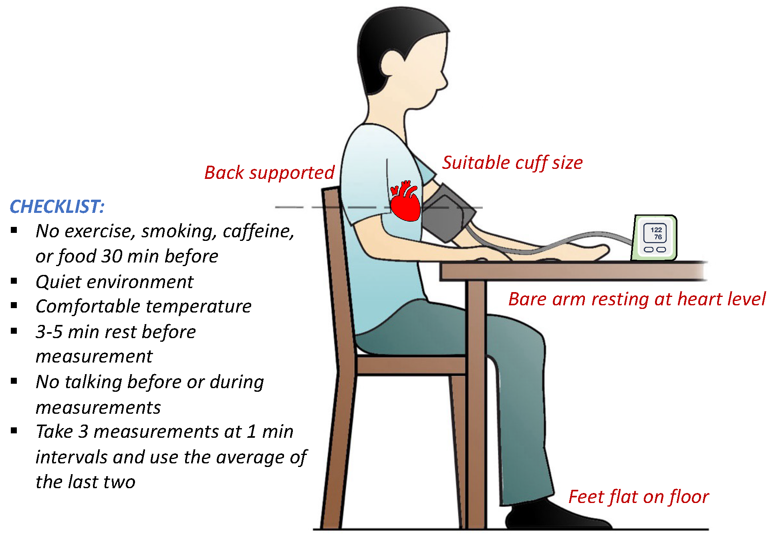
How to measure BP

Slide 23
Important terms
Systolic BP: arterial BP during systole (maximum arterial pulsatile pressure). This is measured using an auscultatory device at the onset of the first Korotkoff sound.
Diastolic BP: arterial BP during diastole (minimum arterial pulsatile pressure). This is measured using an auscultatory device at the time of complete disappearance of the Korotkoff sounds (fifth sound). If there is no disappearance of sounds (no fifth sound) then the fourth Korotkoff sound (muffling) is used to estimate diastolic BP
Inter-arm difference: systolic BP difference of >10 mmHg when BP is measured sequentially in each arm
Postural/orthostatic hypotension: decrement of ≥20 mmHg in systolic BP and/or ≥10 mmHg in diastolic BP when BP is measured in the standing position at 1 and/or 3 min after standing following a 5-min period in the sitting or lying position.
White-coat hypertension: BP that is above the threshold for diagnosing hypertension in the office but below the threshold in home/ambulatory settings, e.g. ≥140/90 mmHg in office but <135/85 mmHg at home/ambulatory daytime (or 24-h BP < 130/80 mmHg).

Slide 24
Important terms
Masked hypertension: BP that is below the hypertension diagnostic threshold in the office but above the hypertension diagnostic threshold in home/ambulatory settings, e.g. <140/90 mmHg in clinic but ≥135/85 mmHg at home/ambulatory daytime (or 24-h BP ≥130/80 mmHg).
Office BP: also known as clinic BP. can be measured manually or using an automated device.
Home BP measurement (HBPM): an out-of-office approach to measuring BP when the patient measures their own BP at home using a validated monitor .
Ambulatory BP measurement (ABPM): an out-of-office BP measurement that uses a fully automated oscillometric device, usually for a 24-h period, and measures BP at set intervals.

Slide 25
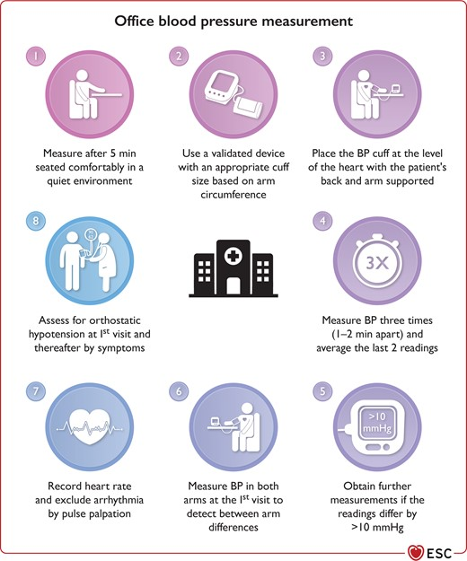
Office BP measurement

Slide 26
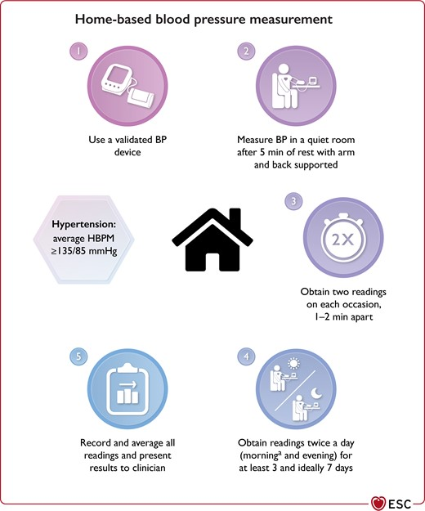
Home BP measurement

Slide 27
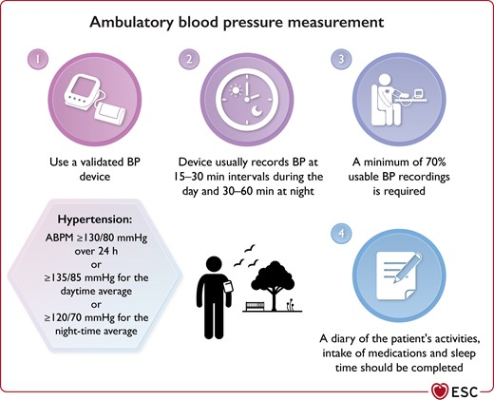
Ambulatory BP measurement

Slide 28
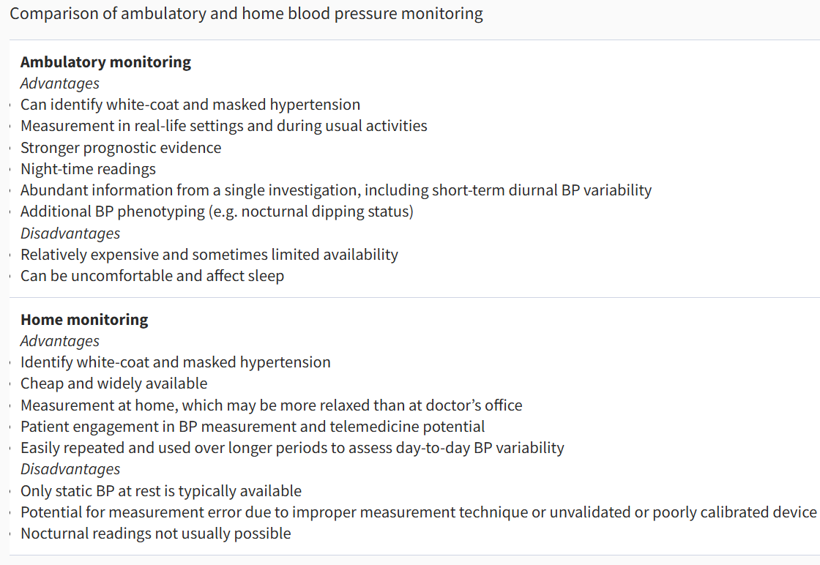
Difference between ambulatory and home BP measurement

Slide 29
Diagnostic work up of a cases of HTN

Slide 30
Step 1: Confirm Diagnosis
✅ Blood Pressure Measurement:
Measure BP on 2+ visits, at least 1 week apart.
Use Automated Office BP (AOBP), Home BP Monitoring (HBPM), or Ambulatory BP Monitoring (ABPM) for accuracy.
Hypertension Diagnosis:
≥140/90 mmHg (Office BP)
≥130/80 mmHg (ABPM or HBPM)

Slide 31
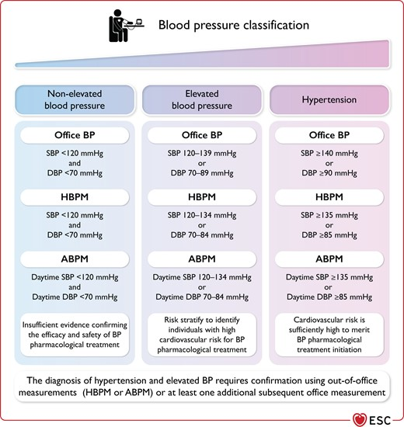

Slide 32
Step 2: Assess Cardiovascular Risk
✅ History & Physical Exam:
Family history of hypertension, CV disease, stroke.
Lifestyle factors: Smoking, diet, alcohol, stress, physical activity.
Symptoms of target organ damage (e.g., vision changes, chest pain, fatigue).
✅ Clinical Examination:
Fundoscopy → Hypertensive retinopathy.
Cardiac exam → Murmurs (Aortic Coarctation), S4 (LVH).
Peripheral pulses → Delayed femoral pulse (Aortic Coarctation).

Slide 33
Step 3: Basic Laboratory Tests (To Assess Organ Damage & Identify Secondary HTN)
✅ Blood Tests:
Complete Blood Count (CBC) → Anemia (CKD)
Fasting Blood Glucose & HbA1c → Diabetes
Lipid Profile → Dyslipidemia
Serum Electrolytes (Na+, K+, Ca2+) → Hypokalemia (Aldosteronism)
Renal Function Tests (BUN, Creatinine, eGFR) → CKD
Liver Function Tests → Rule out secondary causes
✅ Urine Tests:
Urinalysis (Proteinuria, Hematuria) → CKD
24h Urine Protein & Albumin/Creatinine Ratio → Early kidney damage
✅ ECG:
Left Ventricular Hypertrophy (LVH)
Ischemic changes (ST/T wave abnormalities)
✅ Echocardiogram (If Indicated):
LVH, Systolic/Diastolic Dysfunction

Slide 34
Step 4: Identify Secondary Hypertension
✅ Renovascular HTN (Renal Artery Stenosis):
Renal Doppler Ultrasound, CT Angiography, or MRA
✅ Primary Aldosteronism:
Plasma Aldosterone/Renin Ratio (ARR)
Confirmatory Tests: Saline Load, Fludrocortisone Suppression
✅ Pheochromocytoma:
Plasma Free Metanephrines & 24h Urinary Catecholamines
CT/MRI Adrenal Glands
✅ Cushing’s Syndrome:
Overnight Dexamethasone Suppression Test
24h Urine Free Cortisol
✅ Obstructive Sleep Apnea (OSA):
Polysomnography (Sleep Study)
✅ Coarctation of Aorta:
Echocardiography, CT Angiography, MRI

Slide 35
Treatment of hypertension

Slide 36
1️⃣ Non-Pharmacologic Treatment
✅ Weight loss (Target BMI <25 kg/m²) ✅ DASH Diet (Low sodium, High potassium, fruits, veggies) ✅ Exercise (≥150 min/week moderate aerobic exercise) ✅ Reduce Alcohol, Stop Smoking ✅ Stress Management (Meditation, Yoga, Sleep Hygiene)

Slide 37
Pharmacologic Treatment of Hypertension
✅ Goal: Reduce BP to prevent cardiovascular & renal complications.
✅ First-Line Agents: ACE Inhibitors (ACEi), Angiotensin Receptor Blockers (ARBs), Calcium Channel Blockers (CCBs), Thiazide Diuretics.
✅ Second-Line & Adjuncts: Beta-Blockers, Aldosterone Antagonists, Loop Diuretics, Alpha-Blockers, Direct Vasodilators.

Slide 38
ACE Inhibitors (ACEi)
Examples: Lisinopril, Enalapril, Ramipril
Indications:
First-line in most patients
Chronic kidney disease (CKD) → Reduces proteinuria
Heart failure with reduced ejection fraction (HFrEF)
Post-myocardial infarction (MI)
Diabetes mellitus
🚫 Contraindications:
Pregnancy (Teratogenic)
Bilateral renal artery stenosis
History of angioedema
Hyperkalemia

Slide 39
Angiotensin Receptor Blockers (ARBs)
Examples: Losartan, Valsartan, Candesartan
Indications:
Alternative to ACE inhibitors (ACEi intolerance – cough/angioedema)
CKD with proteinuria
HFrEF
Hypertension with diabetes
🚫 Contraindications:
Pregnancy
Bilateral renal artery stenosis
Hyperkalemia

Slide 40
Calcium Channel Blockers (CCBs)
Dihydropyridines: Amlodipine, Nifedipine Non-Dihydropyridines: Verapamil, Diltiazem
Indications:
First-line in most patients (especially elderly & African Americans)
Isolated systolic hypertension
Angina (Diltiazem, Verapamil)
Atrial fibrillation (Rate control – Verapamil, Diltiazem)
🚫 Contraindications:
Non-DHP CCBs (Verapamil, Diltiazem) → Avoid in heart failure with reduced ejection fraction (HFrEF) & bradycardia
Hypotension

Slide 41
Thiazide Diuretics
Examples: Hydrochlorothiazide, Chlorthalidone, Indapamide
Indications:
First-line in most patients
Isolated systolic hypertension (Elderly)
Heart failure (Adjunct)
Osteoporosis (Reduces urinary calcium loss)
🚫 Contraindications:
Gout (Increases uric acid levels)
Hypokalemia, Hyponatremia
Severe CKD (Ineffective with eGFR <30 mL/min)

Slide 42
Beta-Blockers
Examples: Metoprolol, Carvedilol, Atenolol, Propranolol
Indications:
Not first-line unless specific indications:
Coronary artery disease (CAD) / Post-MI
Heart failure with reduced ejection fraction (HFrEF)
Tachyarrhythmias (Atrial fibrillation)
Hyperthyroidism (Propranolol)
🚫 Contraindications:
Asthma, COPD (Non-selective beta-blockers like propranolol)
Bradycardia, Heart block
Decompensated heart failure

Slide 43
Aldosterone Antagonists
Examples: Spironolactone, Eplerenone
Indications:
Resistant hypertension (BP uncontrolled despite 3 drugs)
Heart failure with reduced ejection fraction (HFrEF)
Primary aldosteronism
🚫 Contraindications:
Hyperkalemia
Severe kidney disease (eGFR <30 mL/min)

Slide 44
Loop Diuretics
Examples: Furosemide, Bumetanide, Torsemide
Indications:
Hypertension with heart failure
Severe CKD (eGFR <30 mL/min)
Edema (Heart failure, Liver cirrhosis, Nephrotic syndrome)
🚫 Contraindications:
Severe electrolyte disturbances (Hypokalemia, Hypomagnesemia)
Hypovolemia

Slide 45
Alpha-Blockers
Examples: Prazosin, Doxazosin, Terazosin
Indications:
Hypertension with benign prostatic hyperplasia (BPH)
Pheochromocytoma (Pre-surgery BP control)
🚫side effects :
Orthostatic hypotension
Reflex tachycardia

Slide 46
Direct Vasodilators
Examples: Hydralazine, Minoxidil
Indications:
Resistant hypertension
Hypertension in pregnancy (Hydralazine)
Heart failure (Hydralazine + Nitrates in African Americans)
🚫 Contraindications:
Severe coronary artery disease (CAD) (May trigger angina)
Reflex tachycardia

Slide 47
Management of hypertensive emergencies
Hypertensive emergency is BP ≥180/120 mmHg with acute target organ damage (e.g., stroke, myocardial infarction, acute kidney injury, aortic dissection, hypertensive encephalopathy).

Slide 48
Management Plan of HTN emergencies:
1. Immediate Steps
Confirm BP with repeated measurements.
Assess for signs of organ damage (neurological, cardiac, renal, retinal).
Obtain relevant history (medications, symptoms, comorbidities).
Perform focused clinical examination.
2. BP Reduction Goals
Lower Mean Arterial Pressure (MAP) by 10-20% in the first hour.
Further reduction of 5-15% over the next 24 hours.
Exceptions:
Aortic dissection, eclampsia, or pheochromocytoma crisis → Reduce SBP to <140 mmHg within the first hour.

Slide 49
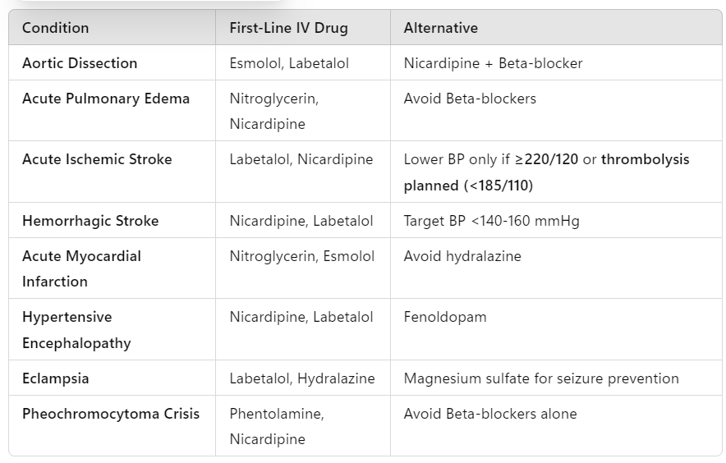
Medications used in HTN emergencies

Slide 50
Management Plan of HTN emergencies:
4. Monitoring & Follow-Up
ICU admission for close BP monitoring in severe cases.
Monitor for complications (neurological, cardiac, renal function tests).
Transition to oral therapy once BP is stabilized.
5. Caution: Avoid Rapid BP Reduction
Excessive BP drop can cause ischemia (stroke, MI, renal failure).
Gradual reduction is key, except for life-threatening conditions like aortic dissection or eclampsia.

Slide 51
Conclusion:
Hypertension remains a major public health challenge due to its high prevalence and significant impact on cardiovascular morbidity and mortality.
Early detection, lifestyle modification, and appropriate pharmacological therapy are crucial in preventing complications.
A structured approach, including regular screening and individualized management, is key to improving patient outcomes.

Slide 52
Take home message
Hypertension is a silent killer .
Early detection through routine screening is crucial.BP classification has evolved –
Proper categorization ensures effective management .
Primary hypertension is more common, but secondary causes should not be overlooked.
Lifestyle modifications are the foundation of treatment – diet, exercise, and weight control.
Pharmacological therapy is tailored – based on patient profile, comorbidities, and contraindications.
Hypertensive emergencies require immediate intervention – careful BP reduction prevents complications.
Long-term follow-up is key adherence to treatment prevents cardiovascular morbidity and mortality.

Slide 53
Quiz 1
A 55-year-old male presents with persistent blood pressure readings of 150/95 mmHg on three separate visits. He has no known medical history. What is the most likely diagnosis?
A) Normal blood pressure B) Elevated blood pressure C) Hypertension Stage 1 D) Hypertension Stage 2
Answer: D) Hypertension Stage 2

Slide 54
Quiz 2
A 40-year-old female presents with new-onset hypertension (BP 170/110 mmHg). She has a history of muscle weakness, polyuria, and hypokalemia. Which underlying cause of secondary hypertension is most likely?
A) Pheochromocytoma B) Primary hyperaldosteronism C) Renal artery stenosis D) Cushing’s syndrome
Answer: B) Primary hyperaldosteronism

Slide 55
Quiz 3
A 65-year-old patient with hypertension and chronic kidney disease (CKD) requires antihypertensive therapy.
Which of the following drug classes is preferred?
A) Thiazide diuretics B) ACE inhibitors C) Beta-blockers D) Calcium channel blockers
Answer: B) ACE inhibitors

Slide 56
Thank You

